Slide 1
HxGN MineOperate
Working with
Data Importers
Edgar Sepulveda
Global Technical Manager, MineOperate
Date 10/10/2022
Version 1.3

Slide 2

Purpose
This session
At the end of this module, you will:

Slide 3
Working with Data Importers
- We request a csv file with grade information and local coordinates information for each one of the vertices that create the grade boundary.
- We update grade_importer.rb file to read csv data from file.
- We create a patch for OP Pro Manager application to add the new grade_importer.rb file.

Slide 4
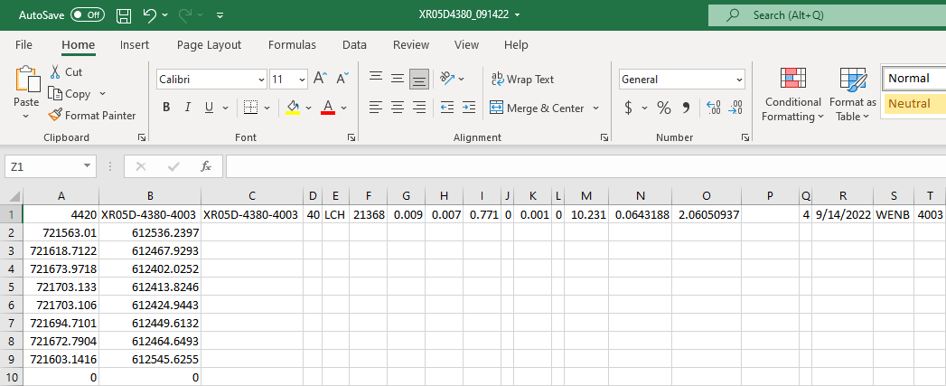
Working with Data Importers

Slide 5
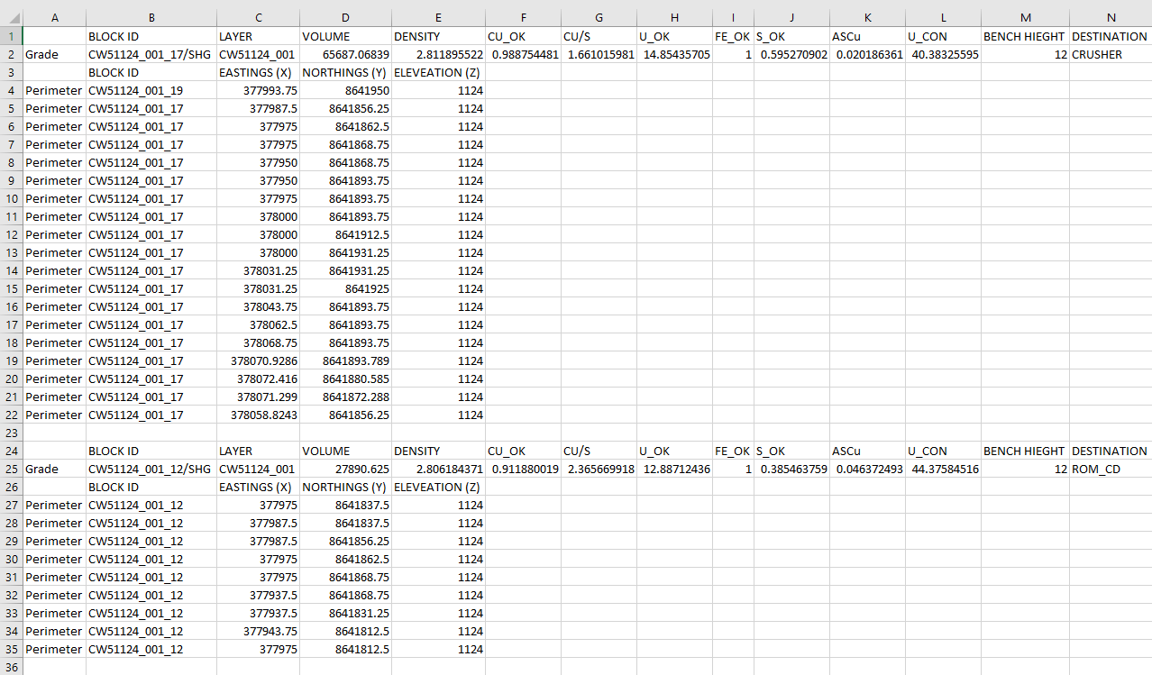
Working with Data Importers

Slide 6
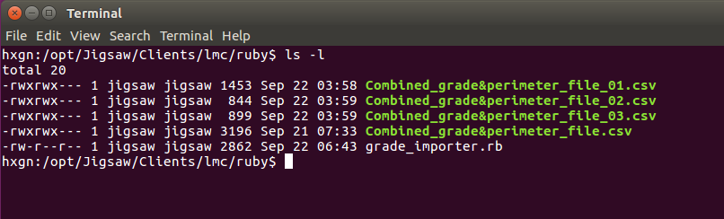
Working with Data Importers

Slide 7
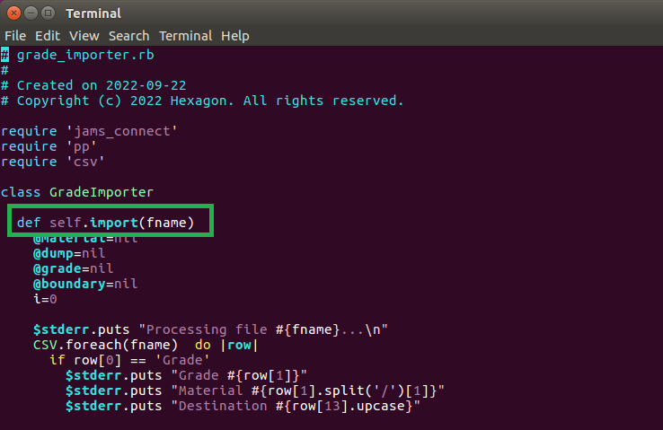
Working with Data Importers

Slide 8
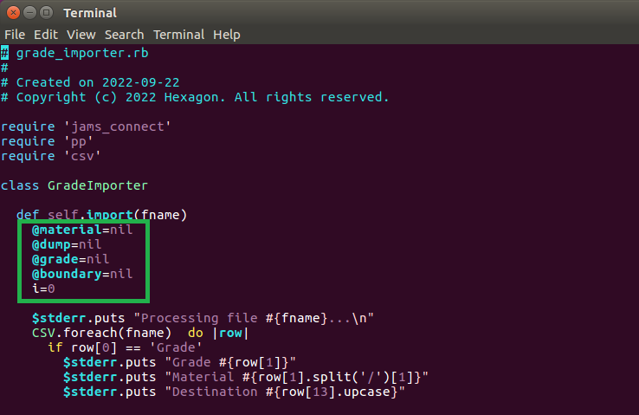
Working with Data Importers

Slide 9
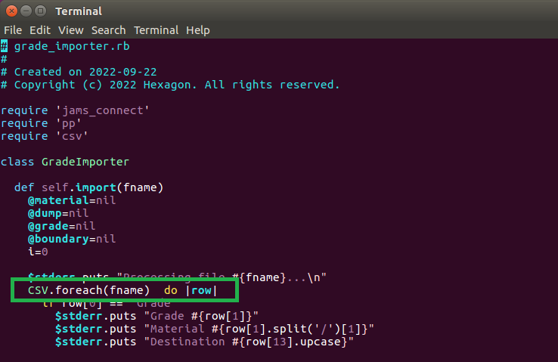
Working with Data Importers

Slide 10
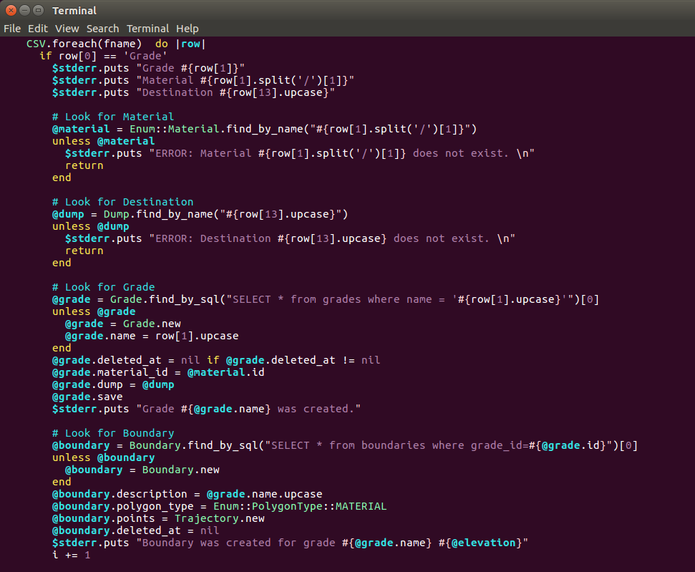
Working with Data Importers

Slide 11
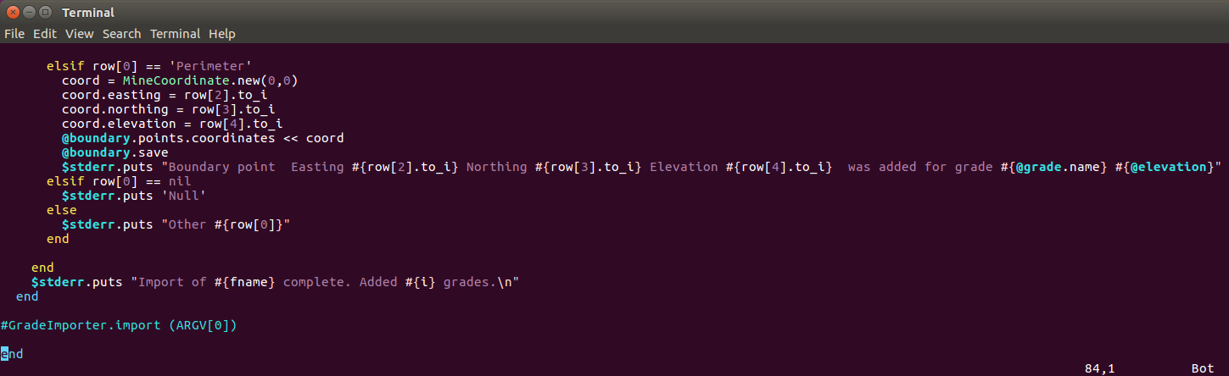
Working with Data Importers

Slide 12
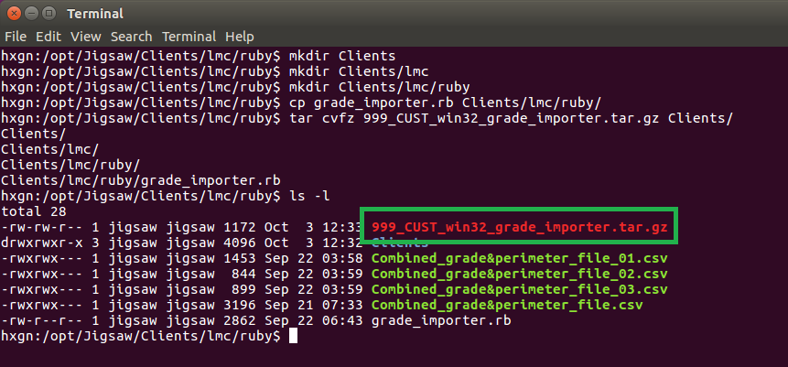
Working with Data Importers

Slide 13

THANK
Y
O
U

